Slide 1
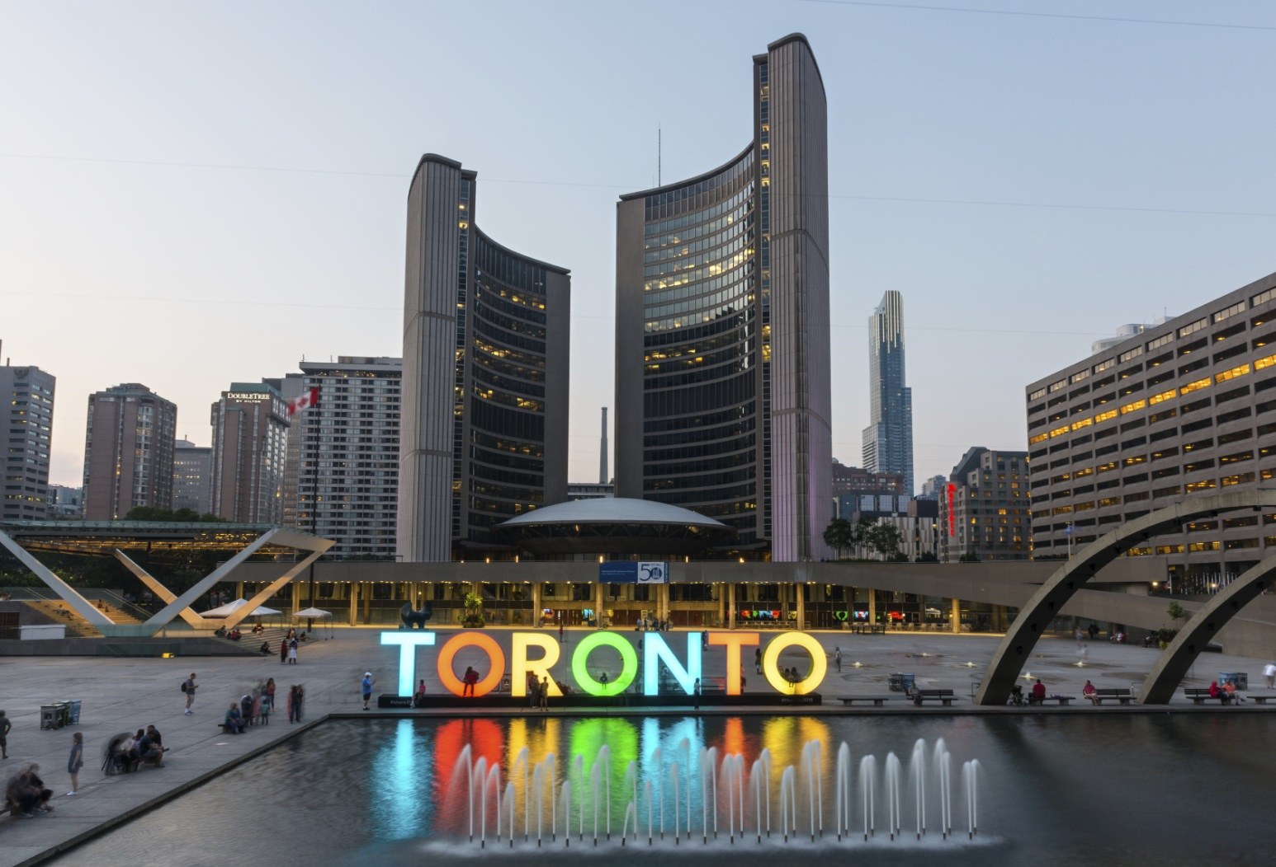
Business Trip Downtown Toronto

Slide 2
A profitable journey makes business sense
To travel wisely is to embark on the informative and factual road
A good business journey is to plan ahead
- To minimise the following:
MONEY MISMANAGEMENT
TRAVEL TIME MISMANAGEMENT
DEVIATION OF BUSSINES PERSPECTIVES
BAD RAPPORT WITH STAKEHOLDERS

Slide 3
Data requisites and cleaning
Canadas postal codes data scrapped from the web
Via wikipedia 'https://en.wikipedia.org/wiki/List_of_postal_codes_of_Canada:_M‘ (providing us with 103 rows and 3 features of raw data)
In addition a CSV file was outsourced due to changes in tarifs using the google API. CSV file was read into data frame to acquire coordinates that match the derived postal codes.
In total 103 rows and 5 features of cleaned data.

Slide 4
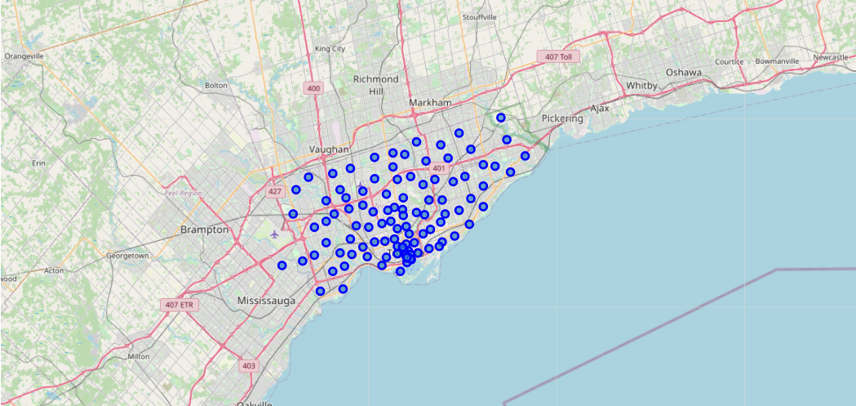
Visualising our clean data
A Map of Toronto with all the blue dots depicting its neighbourhoods
Notes:
A Map of Toronto with all the blue dots depicting its neighbourhoods.

Slide 5
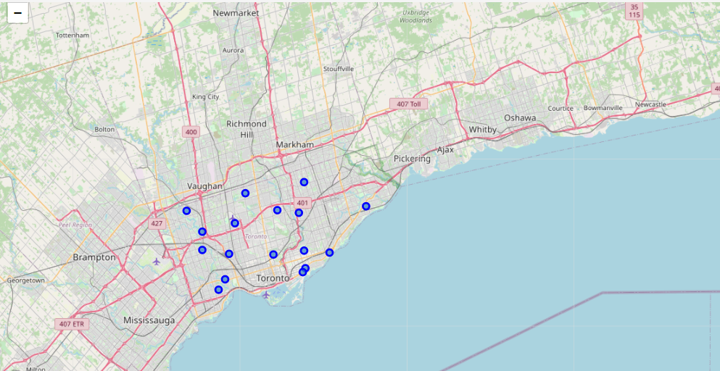
As per client - visuals were narrowed specifically to downtown toronto

Slide 6
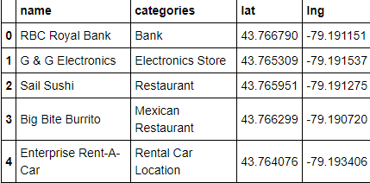
To provide our client with a subtle taste of what Down Town Toronto posses we further explored one of its Neighbourhoods in depth - Regent Park, Harbourfront
Foursquare was utilised to derive venue details.
Results from the Json file were expertly cleaned to once again equip the data into pandas dataframe.
9 venues were returned by fourSquare

Slide 7
Exploratory analysis
As you can imagine our client is now eager to unveil more of what Toronto has to offer , with that being we will now explore all neighbourhoods in Downtown Toronto. So next we will create a function that to repeat the same process to all the neighbourhoods in Downtown Toronto.
Resulting dataframe : 134 rows and 7 features (see next slide )

Slide 8
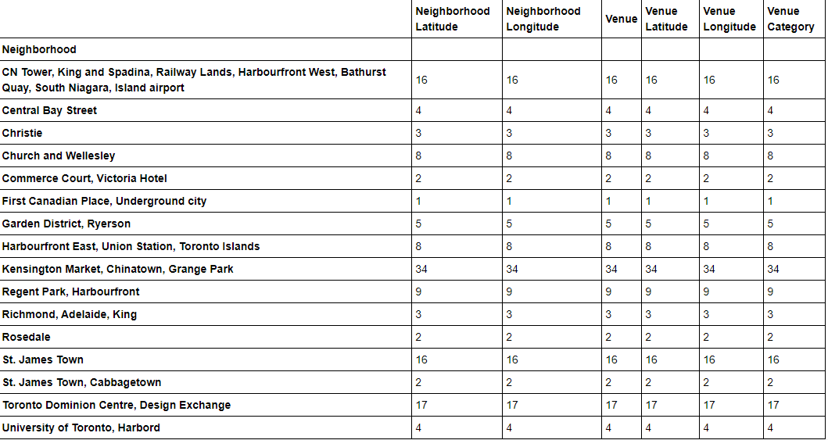
71 unique categories returned

Slide 9
More exploratory work
During our ongoing findings and constant communication with our client it was concluded that as much as our focal point was to discover the vasteness of the two city it would also be of great importance to also examine other surrounding and most frequent venues to assist our client further as to what other aspects attract people. (To accomplish this we group rows by neighbourhood and by taking the mean of the frequency of occurrence of each category.)
To give our client an intuitive analysis in a concise manner we then display the top 10 venues for each neighbourhood.

Slide 10
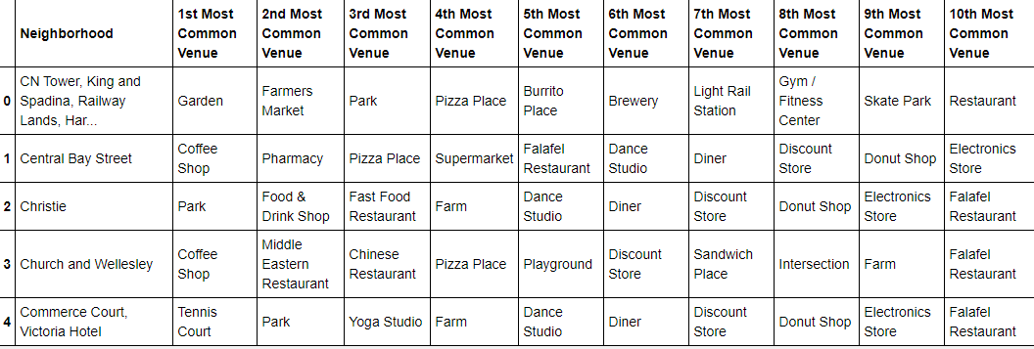
Top 10 venues in each neighbourhood
16 neighbourhoods were generated but for presentation on the below will only be visualised

Slide 11
Algorithm
For this project we chose the K-means CLUSTERING machine learning algorithm based on its accuracy and simplicity. (With that being said we will Run K-means to cluster the neighbourhoods into 5 clusters.)
We created a new dataframe that includes the cluster as well as the top 10 venues for each neighbourhood.

Slide 12
Examine the cluster
Now we can examine each cluster and determine the discriminating venue categories that distinguish each cluster.

Slide 13
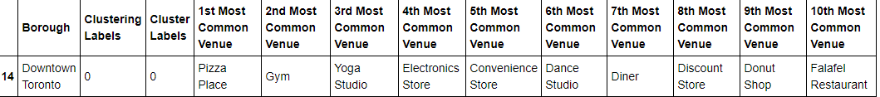
Cluster label 0

Slide 14
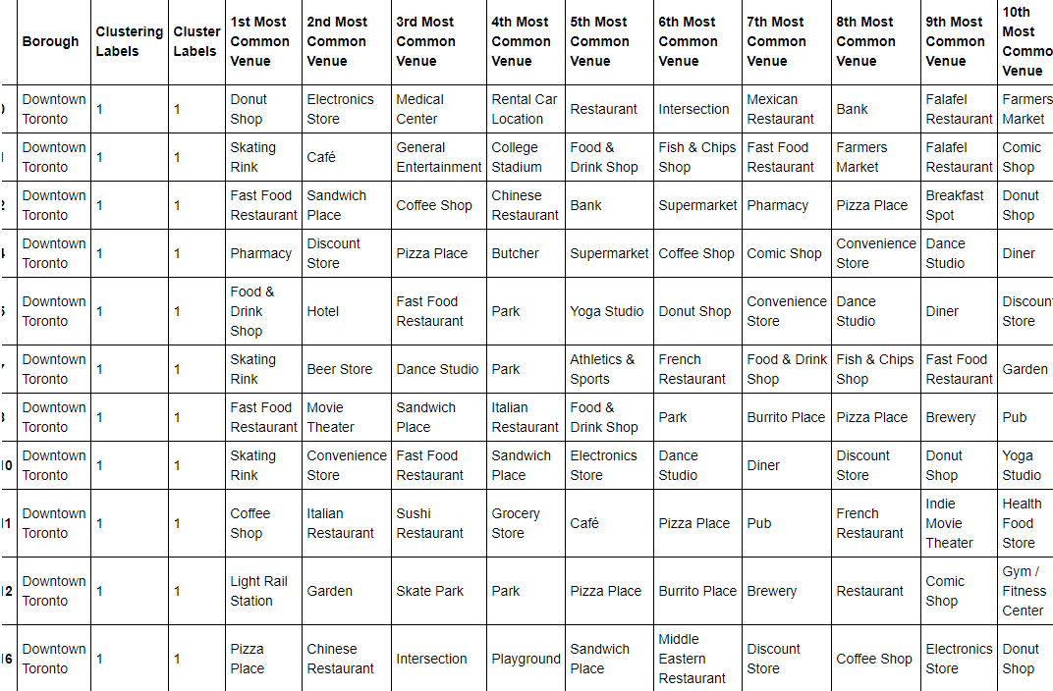
Cluster label 1

Slide 15
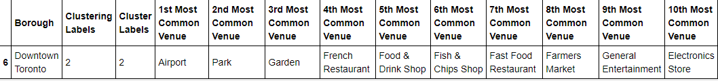
Cluster label 2

Slide 16
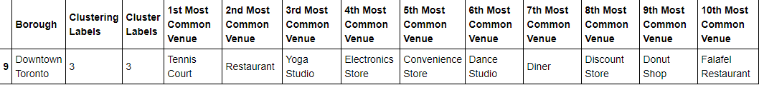
Cluster label 3

Slide 17
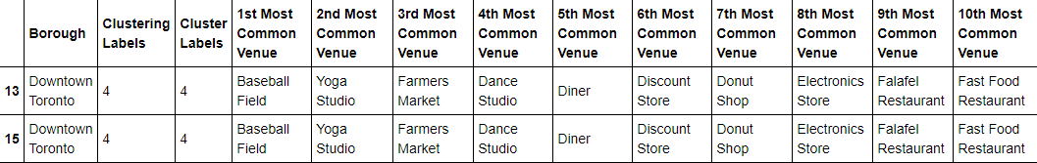
Cluster label 4

Slide 18
Client business trip conclusion
Final decision on the optimal location within the DownTown Toronto region based on a comprehensive and mostly volume based characteristic of neighbourhood’s venues and direct business needs encapsulated with a great tourist experience. It was decided that Cluster 5 emanating from our algorithm proved to provide more variety than all other clusters, and the following locations were chosen to be her priority upon landing in the city of Toronto -*Kensington Market, Chinatown, Grange Park {these locations were chosen predominately due to its high volume of venues and variety in restaurants. With these results we are determined that our client and her associated stakeholders will be able to make further informed and acute business models upon her return to South Africa.

